Slide 1


Professional Development – Continuing Education and Skills Development
Susan Chaisson Schueller
9th Annual IEEE Information Technology Professional Conference
Trenton Computer Festival
The College of New Jersey
March 15, 2014

Slide 2
Agenda
Background
Keeping up with technology and skills development through ongoing education
Overcoming challenges during pursuit of further education
Diversifying skills (wearing more than one hat)
Seeking a mentor, becoming a mentor
Career and skill development
Building confidence and validating knowledge
Q&A, Comments

Slide 3
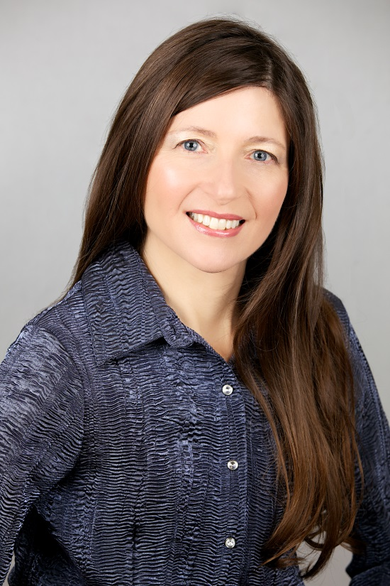
Susan Chaisson Schueller
Experience
Diverse Career in Software Engineering
Quality Assurance, Release Engineering, Configuration/Data Management
Education and Certification
Candidate, M.S. Information Technology, UMass Lowell
(~ 80% complete, part-time, on-line, 3.85 GPA)
Graduate Certificate of Achievement, Information Technology, UMass Lowell (May 2013)
B.S. Computer Science, UMass Lowell
ASQ Certified Software Quality Engineer
Raytheon Six Sigma Specialist
Affiliations
IEEE/Women In Engineering (Boston Affinity)
Society of Women Engineers (Boston Section)
American Society for Quality (Merrimack Valley, MA Section)
Community
Volunteer Musician, Mentor, Fundraiser/Runner/Walker

Slide 4




IEEE Women In Engineering (WIE)
The mission of IEEE WIE is to facilitate the recruitment and retention of women in technical disciplines globally.
4
14-Mar-14
Notes:
IEEE WIE is a part of IEEE. Our purpose is listed here and mainly we try to help encourage more women to join this field. In doing this we invite men to joins as well because our meeting topics and events apply to everyone.
IEEE WIE Boston is active and growing. It has meetings roughly every other month in and around Boston. Here is our facebook page and website where you can find out more about our meetings and events.

Slide 5
What is WIE Boston?
WIE is an Affinity Group, part of IEEE
Similar to an IEEE technical society
Both women and men – all are welcome!
Worldwide – supported by WIE HQ
WIE Boston meets regularly for technical and professional development events
Networking followed by a speaker
Often cosponsored by fellow IEEE societies
Variety of technical and professional development topics
Notes:
WIE has a small steering committee (Chair, Vice-Chair, Treasurer and Webmaster) who meet monthly to plan our events and activities.
At these events and activities we have lots of networking and each meeting features a speaker and some sort of refreshments. We alternate our topics between technical and career development (“soft skills”) – we try to keep the technical ones “general” enough to apply to anyone in IEEE.
We are trying to reach out to young kids – through organizations like girl scouts, judging at science fairs, etc. Talking to a child when they are young is the best way to let them see what engineering is. We need to put a “face” on it, so they can relate to it.
You can add WIE membership to your annual dues.

Slide 6
WIE Relationships
Partnerships with industry:
iRobot, QualComm, MIT LL, Invensys, Covidien, Northeastern, etc.
Win-Win opportunity for WIE and company
Collaboration and Outreach with other non-profits:
SWE Boston, Science Club for Girls, Schools/science fair judging
We help advertise the event and provide volunteers
Notes:
WIE has a small steering committee (Chair, Vice-Chair, Treasurer and Webmaster) who meet monthly to plan our events and activities.
At these events and activities we have lots of networking and each meeting features a speaker and some sort of refreshments. We alternate our topics between technical and career development (“soft skills”) – we try to keep the technical ones “general” enough to apply to anyone in IEEE.
We are trying to reach out to young kids – through organizations like girl scouts, judging at science fairs, etc. Talking to a child when they are young is the best way to let them see what engineering is. We need to put a “face” on it, so they can relate to it.
You can add WIE membership to your annual dues.

Slide 7
Benefits of WIE
Great for networking
Most meetings are held at location of a Corporate Partner – varied locations
Some meetings cosponsored by other IEEE societies – get to know other parts of IEEE!
Leadership opportunities
Steering Committee is growing!
Meets for coffee every 6 weeks to plan meetings
Notes:
WIE has a small steering committee (Chair, Vice-Chair, Treasurer and Webmaster) who meet monthly to plan our events and activities.
At these events and activities we have lots of networking and each meeting features a speaker and some sort of refreshments. We alternate our topics between technical and career development (“soft skills”) – we try to keep the technical ones “general” enough to apply to anyone in IEEE.
We are trying to reach out to young kids – through organizations like girl scouts, judging at science fairs, etc. Talking to a child when they are young is the best way to let them see what engineering is. We need to put a “face” on it, so they can relate to it.
You can add WIE membership to your annual dues.

Slide 8
Find/Join Us!
On Facebook under “IEEE Boston WIE”
On our website: www.bostonwie.org/
Join our mailing list – everyone welcome!
$25/yr dues includes:
Women in Engineering bi-annual magazine
Women in Engineering monthly newsletter
Free for students and IEEE Life Members!

Slide 9
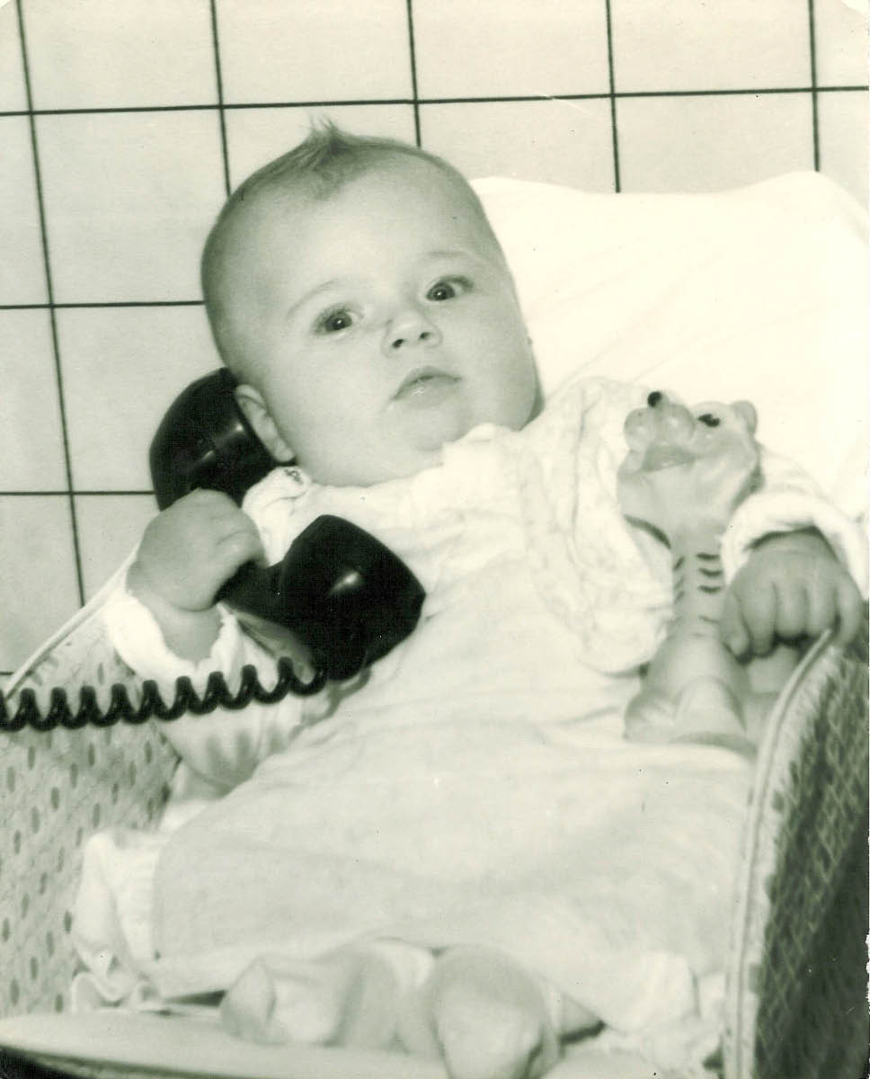
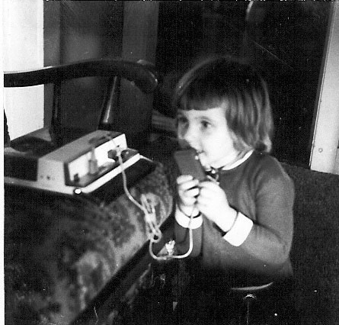
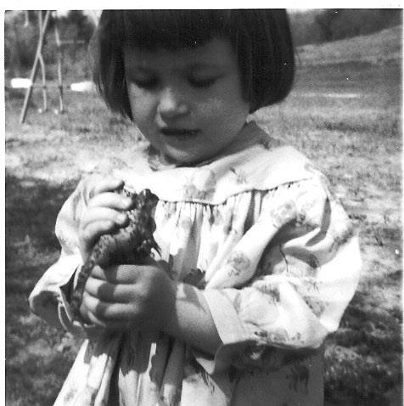
An Early Curiosity in Science and Technology

Slide 10
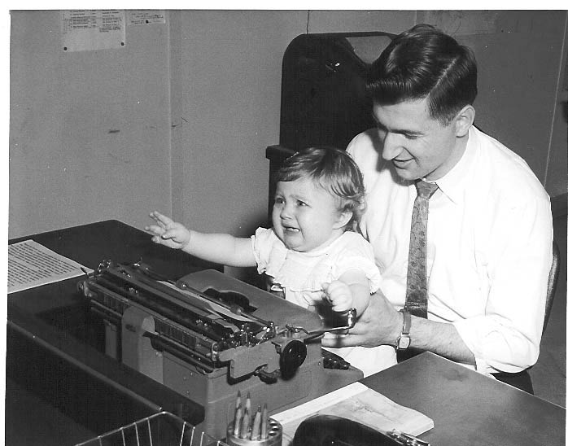
…but sometimes I had a little hesitation for learning new technology

Slide 11
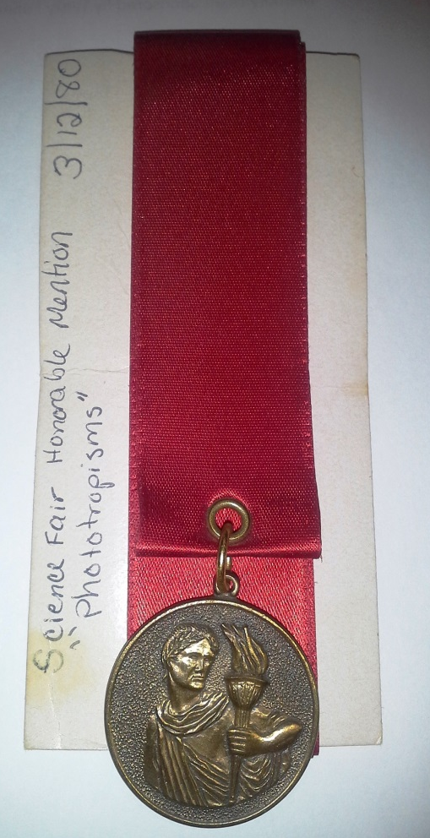
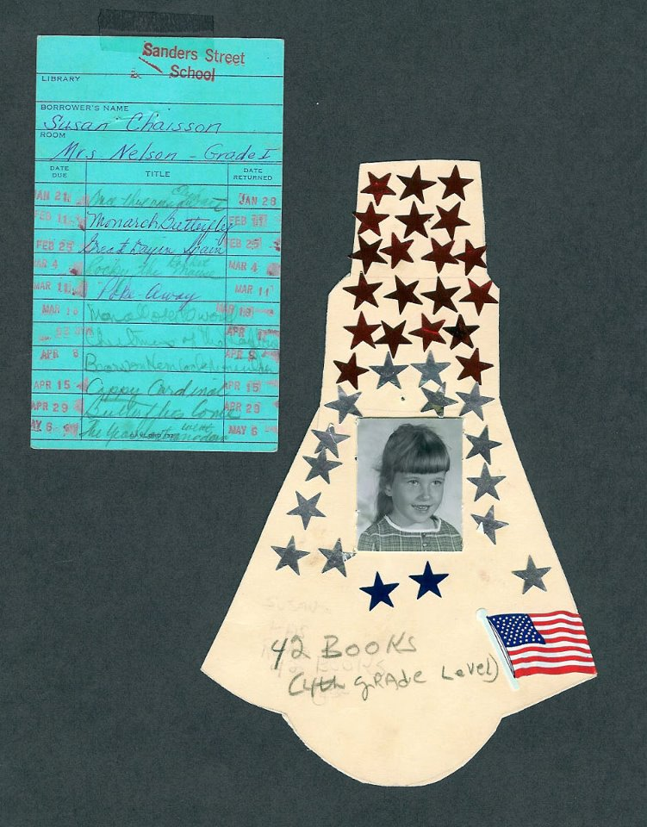
A Drive to Learn and Achieve (thanks to my supportive parents)

Slide 12
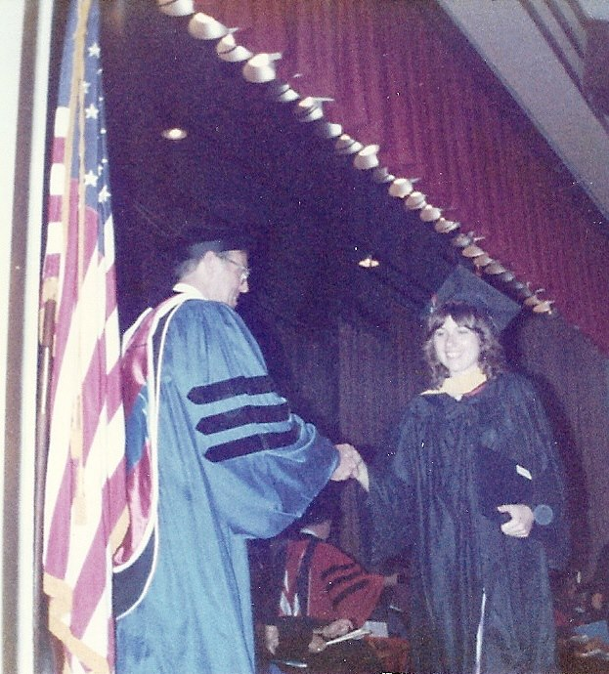

First Step into a Career in Technology
I received my BS in Computer Science in the 1980s – always need to keep my career skill set up-to-date in order to succeed and stay competitive
There are many more career and educational resources available now than back then, thanks to the Internet

Slide 13
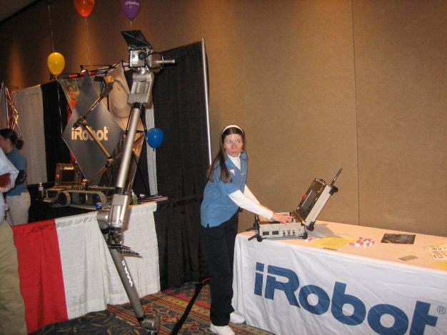
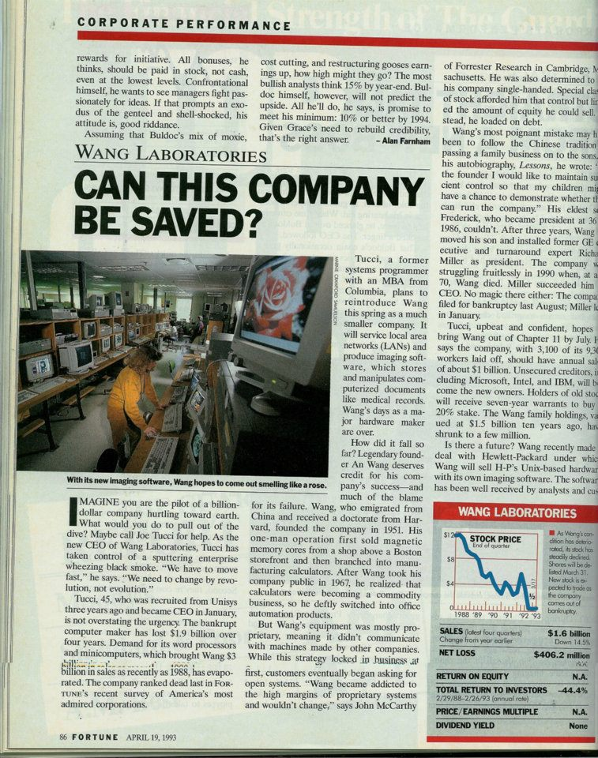
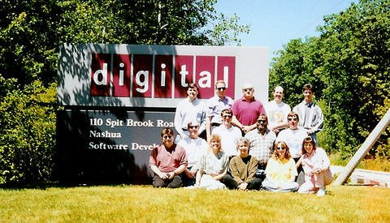
A Career in Technology
Work hard
Have fun
Remember (and Apply) Lessons Learned

Slide 14
Keeping up with Technology and Skills Development
Ongoing education
Short-term courses
On-line and classroom training
Degree programs
IT and related disciplines
Certification and renewals
e.g. Computer forensics certificate programs
Self-paced training
Webinars
YouTube
Learning never ends
“Ancora Imparo” (“I am still learning”) ~ Michelangelo, in his 80s

Slide 15
Overcoming challenges during pursuit of career and learning
Layoffs/downsizing
Keep an eye on what other opportunities are out there – be prepared
Life changes
Build your support system ahead of time
Take a break from the computer, turn off the TV
Fresh air, water, exercise
Focus on positives and build on them
Refresh an old skill
Keep your mind active and challenged

Slide 16
Overcoming challenges during pursuit of career and learning
Find used books at Amazon, local library book sales
Use your local library
Libraries have more than just books
Industry periodicals
Computer equipment
Job search tools and resources
Available meeting rooms for interest groups
Inter-library media sharing
16

Slide 17
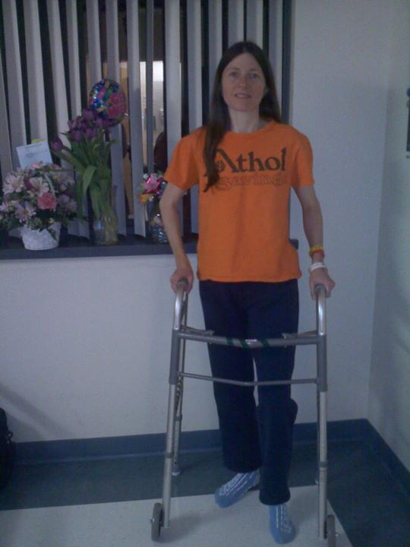
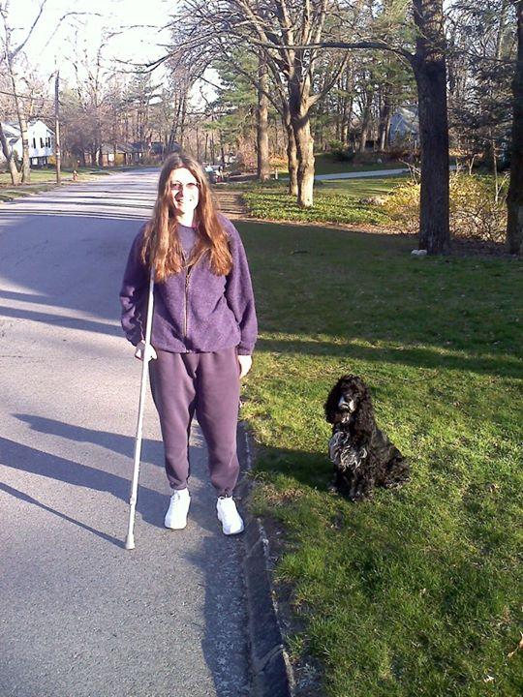
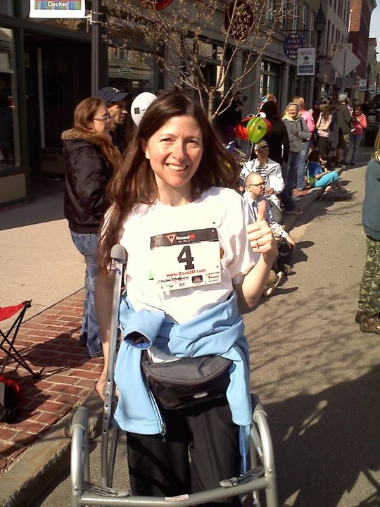

Fear Not Your Challenges – “Spirit Never Broken”
Focus on what you *can* do
Celebrate milestones, big and small

Slide 18
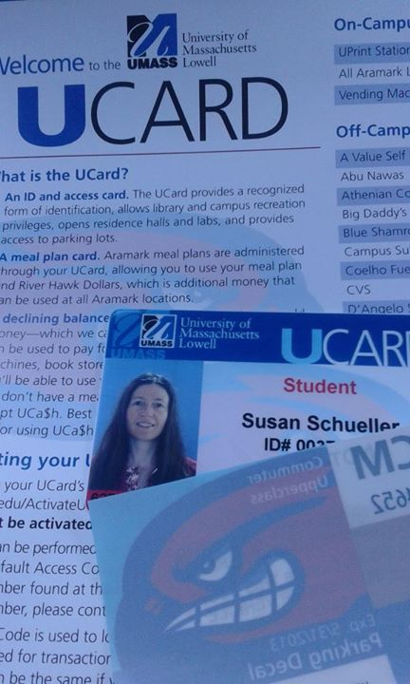

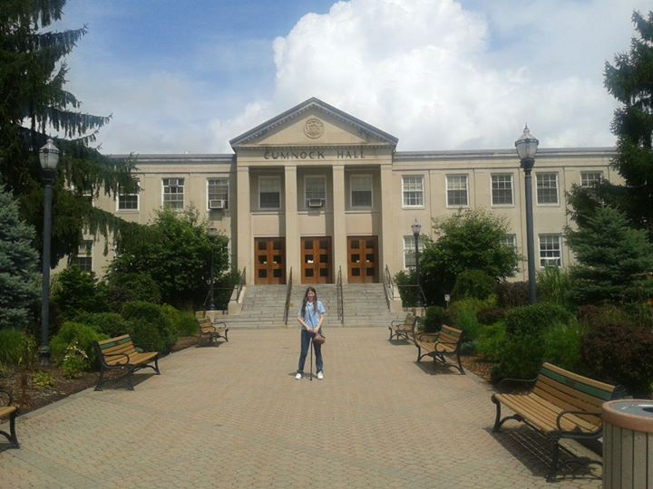
Back to School

Slide 19
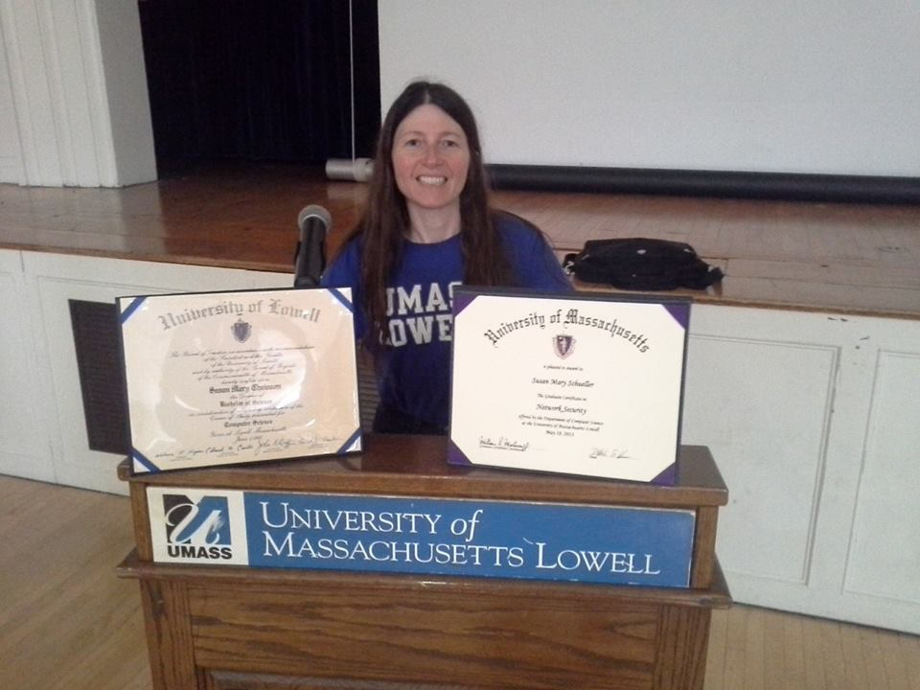
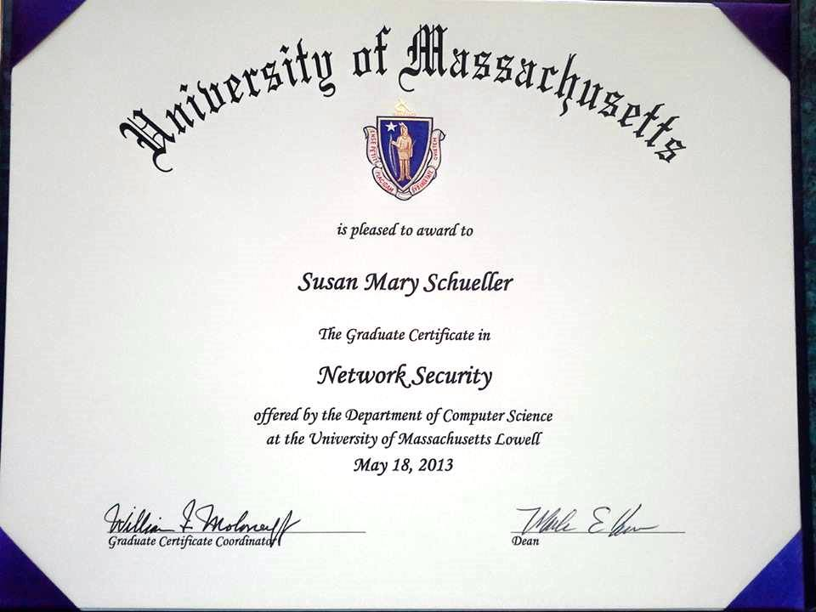
Never Too Late to Go Back to School
Set smaller, achievable goals as you step toward your larger goal
Many technology schools offer advanced IT degrees and certificates online
Keep certifications current

Slide 20
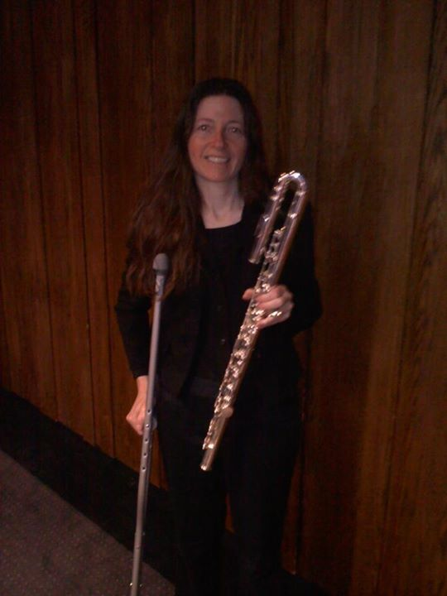
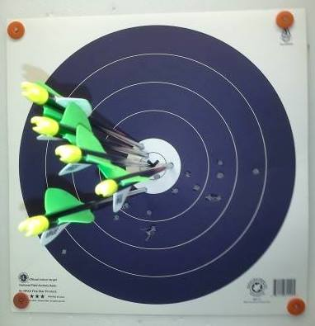
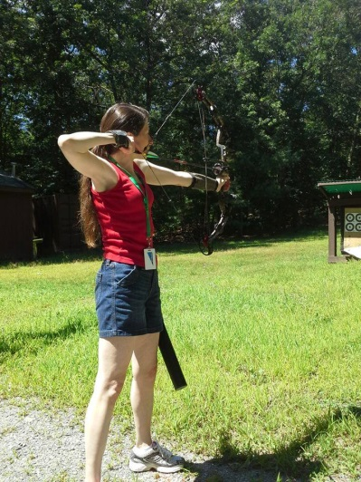
Getting Stronger by Staying Focused
Focus on your abilities, not your limitations
Learn a new skill or hobby to strengthen your confidence
Teach others

Slide 21



Back to Work – Consulting Gigs

Slide 22
Diversifying skills (wearing more than one hat)
IT consulting offers opportunities to learn new skills
E.g. learn a new programming language/software tool, built upon your cumulative knowledge
Note: There are consulting firms which offer competitive benefits
Learn about diverse industries and applications
Medical
Academia
Mobile
Data Mining
Cloud Computing

Slide 23







Diversify Your Experience

Slide 24



Networking and Outreach

Slide 25
Networking
Be selective when networking on-line
Don’t have to accept all Linked-In connection requests
Keep your career profile professional
Keep social networking separate
Recommend and refer others – quid pro quo
Form an interest group
Take the lead on moderating discussions
Sample some existing interest groups
Diversify your interests – be flexible
25

Slide 26
Career and Skill Development
Participate in career and skill development workshops offered by professional organizations
Seek opportunities available for both members and guests
IEEE offers a wide variety of learning resources
http://www.ieee.org/education_careers/index.html
Assess your skill set periodically and often
Browse the job boards to see what skills are most in demand
Audit a class vs. registering for a grade
Cross-train on the job – learn what others do to understand the “big picture"

Slide 27
Building confidence and validating knowledge
Research
Presentations
White Papers
Journal articles
Mentoring
Find a mentor
Be a mentor
Go on interviews even if you aren’t looking
Find out what skills are most in demand
“Phone screens” are beneficial for self-assessment
27

Slide 28
More on Building Confidence and Validating Knowledge
Try a unique job assignment
E.g. Pipe organ repair (applied electrical and mechanical principles)
Build self-confidence with projects
Set your own goals and celebrate your milestones
Home repairs – for yourself and others
Order replacement parts and install (e.g. washer lid, exhaust fan)
Opportunities in community projects
E.g. look for opportunities to help set up Local Area Networks / infrastructure in schools, libraries, community centers

Slide 29
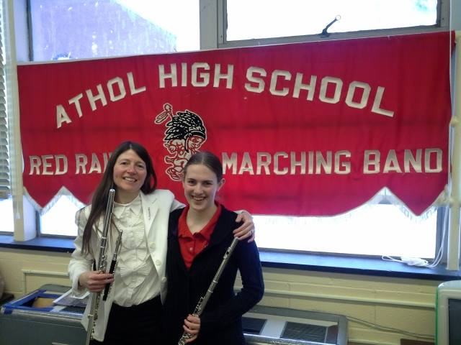
More on Mentoring
IEEE has a mentoring program for both mentors and mentees
http://mentoring.ieee.org/ementor/
With mentoring, everyone learns
Your mentee may ask a question that you may need to research
Be a mentor in a favorite interest – learn mentoring skills
29

Slide 30
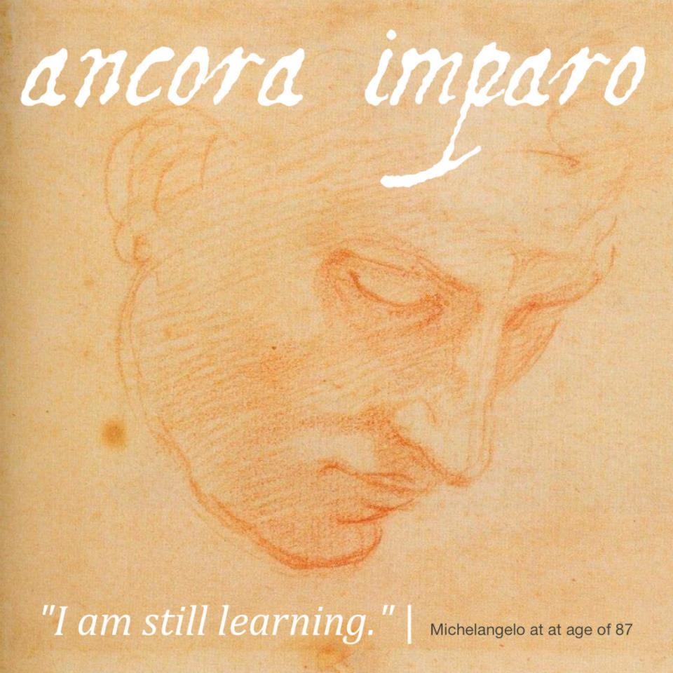
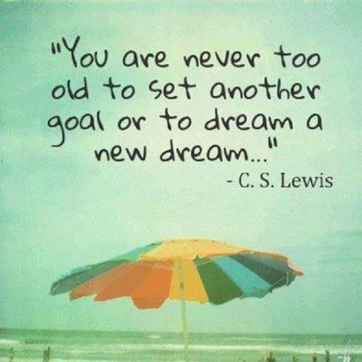
Inspire and Be Inspired

Slide 31



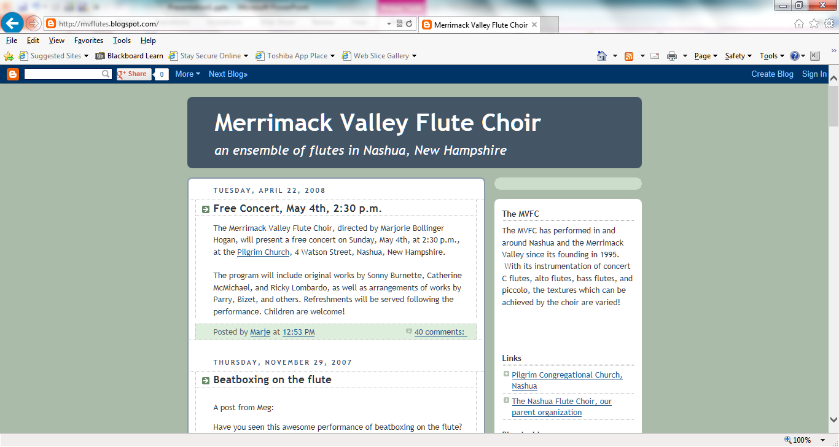




Support and Celebrate Community by Getting Involved (Teamwork Skills)

Slide 32
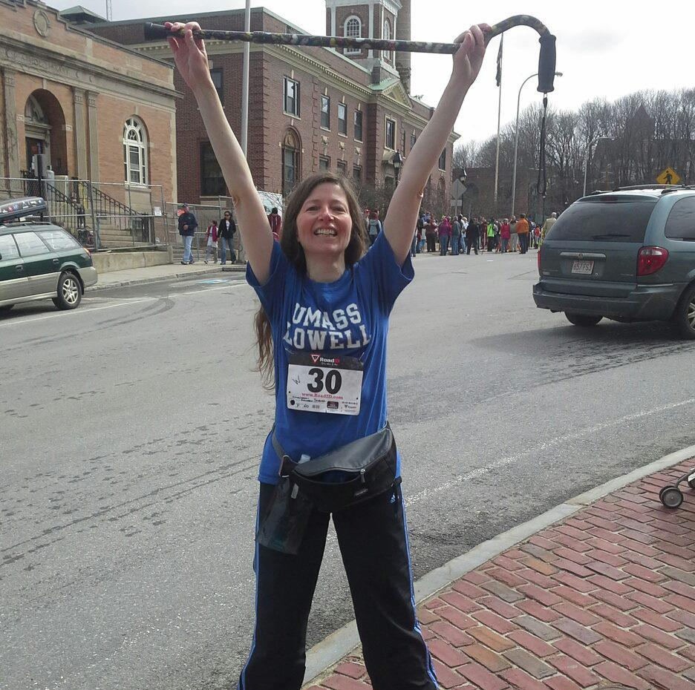
Celebrate Milestones!

Slide 33
Questions, Comments
Share some examples of what has worked for you
Share some ideas
Networking
Mentoring
Updating skill set
Confidence building
Learning opportunities
33

Slide 34
Thank You !
34

Slide 35
Resources
My email: schueller@comcast.net
IEEE
http://www.ieee.org
IEEE/Women In Engineering
http://www.ieee.org/membership_services/membership/women/index.html
Society of Women Engineers
http://www.swe.org (National)
http://www.sweboston.org (Boston Section)
http://aspire.swe.org (K-12 Outreach)
American Society for Quality
http://www.asq.org
LinkedIn: http://www.linkedin.com
Dice: http://www.dice.com
Indeed: http://www.indeed.com

